Slide 1
Introduction to Python 3 Programming: Welcome & Introductions
Kevin Cunningham

Slide 2
Introductions
Course Instructor
Kevin Cunningham
Course attendees
You…
Name
Professional Position
Python / Programming experience
Motivation and Expectations

Slide 3
Course Content
Course objectives
Learn core aspects of the Python language
On this course we are looking at:
What Python is and the make-up of the Python environment
Python Syntax, Types & Flow of control
Python Functions
Error Handling
Automation with Python
Building API with Django

Slide 4
Questions?
?

Slide 5
Python Programming Language
Originates in 1980s created by Guido van Rossum
Several versions current is Python 3.x
A Hybrid Dynamically Typed language
Allows for Procedural Programming
Supports Object Oriented Programming
Facilities Functional Programming
Has dynamic typing, Easily extendible
Has an extensive set of built in and third-party libraries
Graphics, UIs and Graphing
CSV, Excel and databases
Machine Learning and Data Science etc.
…

Slide 6
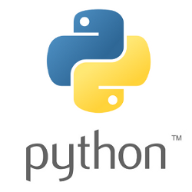
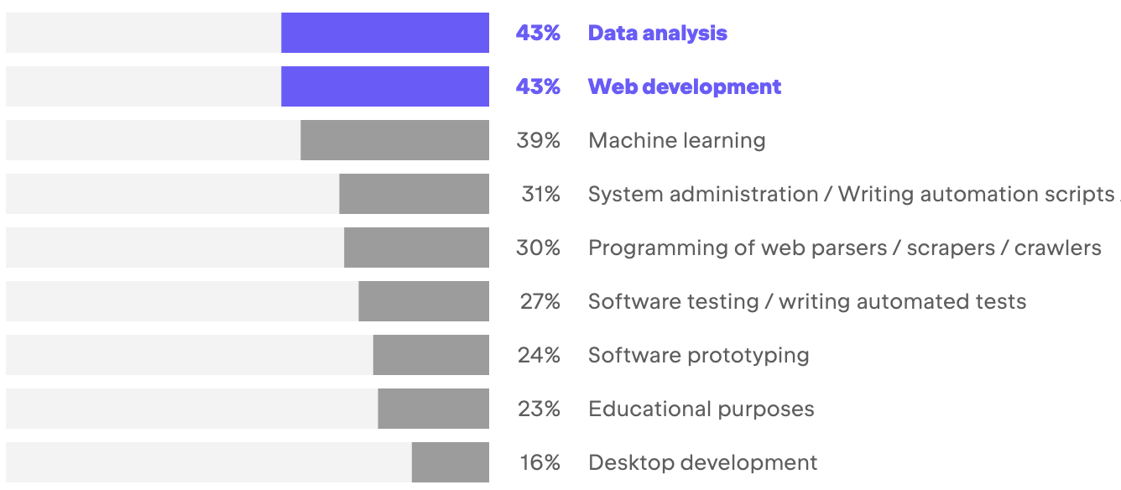
Where is Python Used?
Data Analysis & Web Development most common
Machine Learning catching up
https://www.jetbrains.com/lp/devecosystem-2022/python/

Slide 7
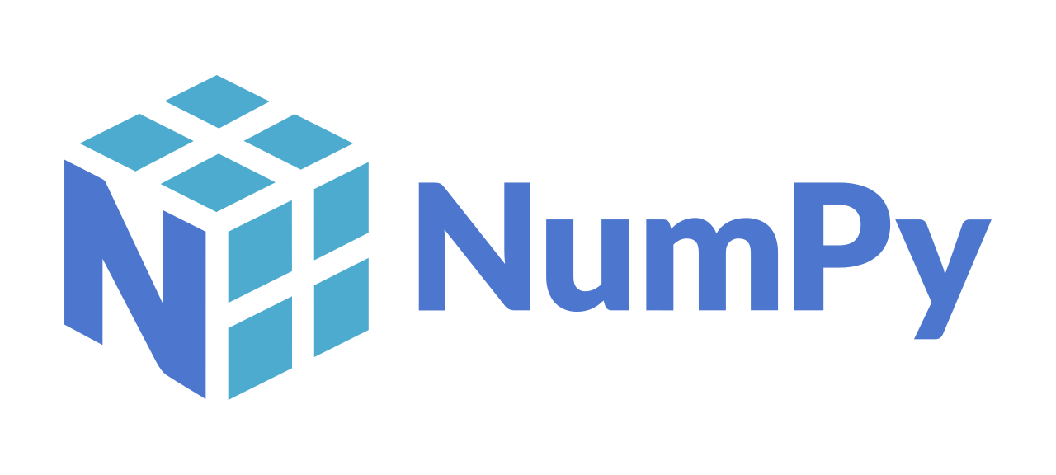

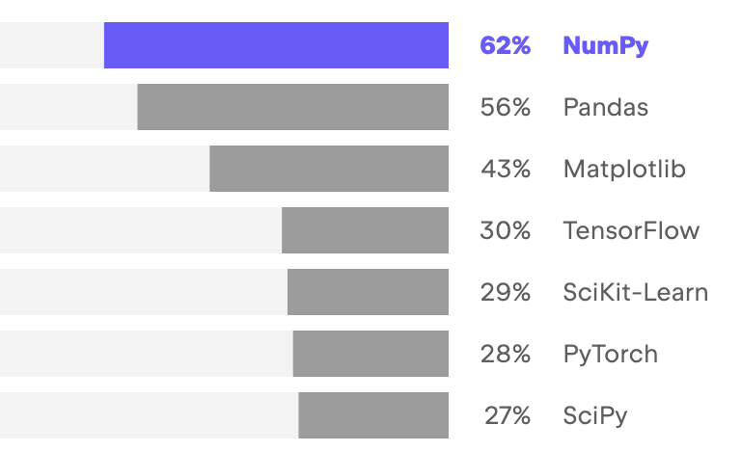
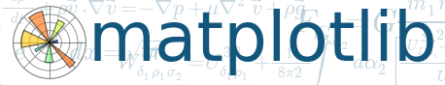

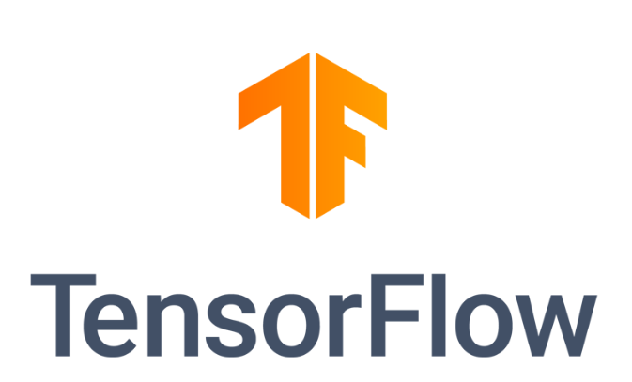
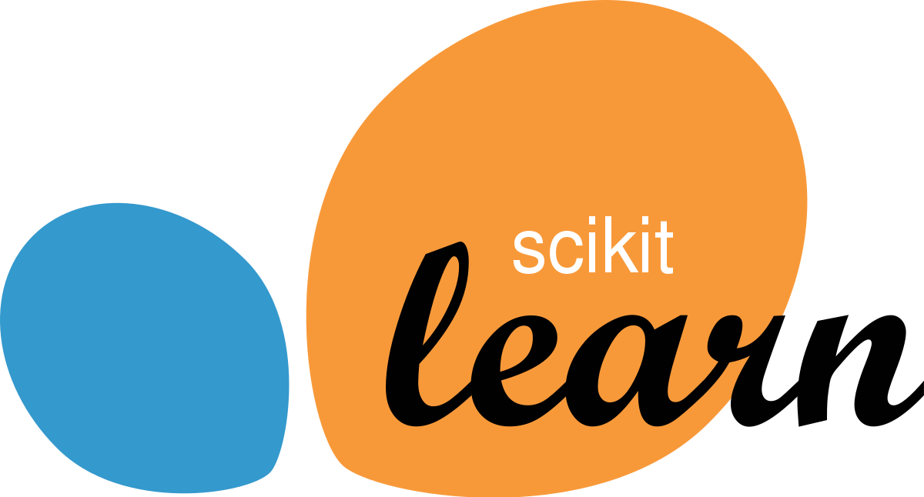
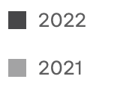
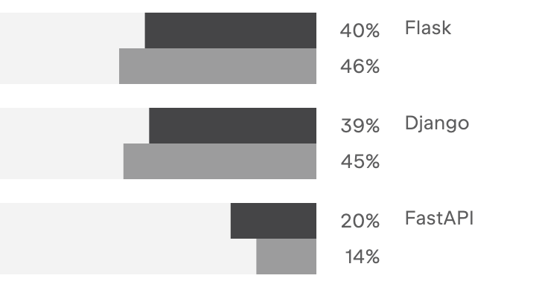
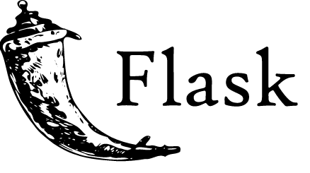

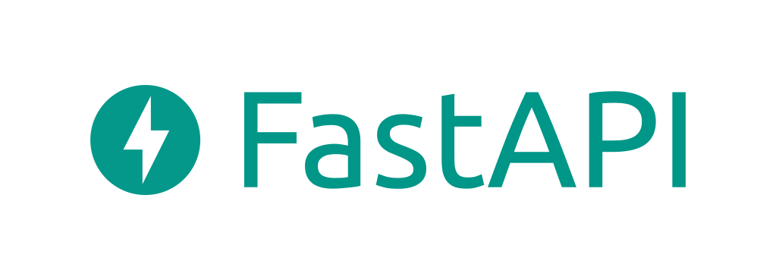
Common Python Libraries
https://www.jetbrains.com/lp/devecosystem-2022/python/
Data Science Libraries
Web Frameworks

Slide 8

Python Execution Model
Not a precompiled language
But not exactly an interpreted language either
Simplified process illustrative of behaviour
Note don’t use ‘-’ in filenames – may cause problems later
Check the Program is valid and well formed
Python
hello.py
(Dynamically) Compile
Into the Intermediate language
Run the intermediate
version of the program
Notes:
The way in which the Python interpreter processes a Python program is broken down into several steps. The steps shown here are illustrative (and simplified) but the general idea is correct.
First the program is checked to make sure that it is valid Python, that is a check is made that the program follows all the rules of the language and that each of the commands and operations etc. is understood by the Python environment.
It then translates the plain text, English like commands, into a more concise intermediate format that is easier to execute on a computer. Python can store this intermediate version in a file which is named after the original file but with a ‘.pyc’ extension instead of a ‘.py’ extension (the ‘c’ in the extension indicates it contains the compiled version of the code).
The compiled intermediate version is then executed by the interpreter.

Slide 9
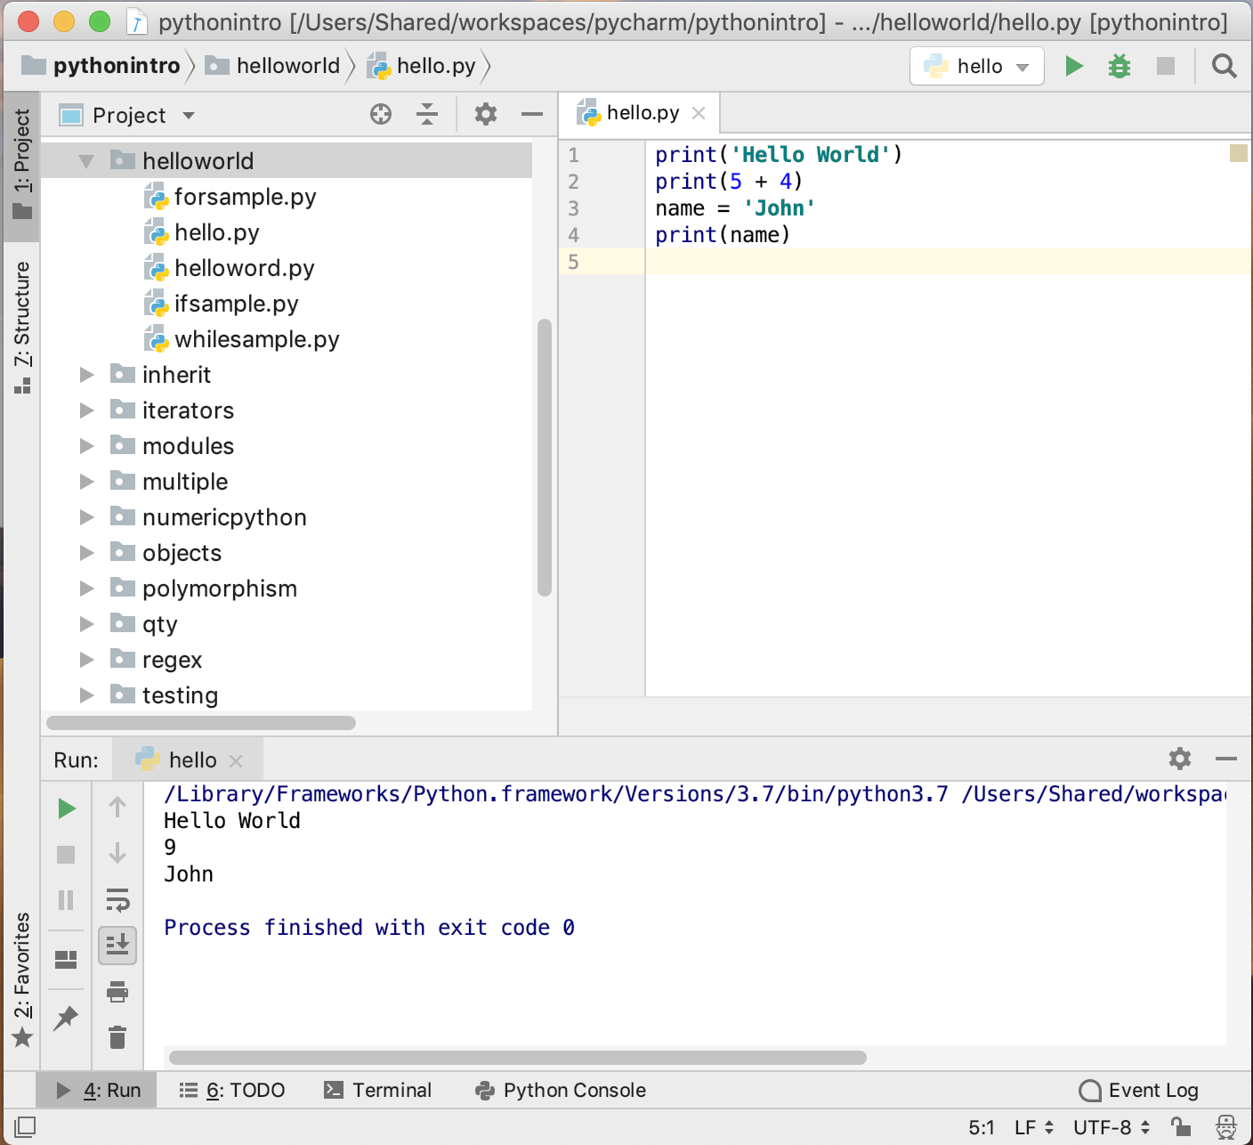
Python IDEs
Several Python IDEs available
PyCharm
both free version
and commercial
Visual Studio Code
Free IDE from Microsoft
Spyder
scientific dev apps
Eclipse + PyDev plugin
Jupyter Notebooks
target data analysis tasks

Slide 10
Python Environments
Typically use a tool to handle Python environments
Required as may have different projects
that use different versions of Python 3.7, 3.8, 3.9, 3.10 etc.
that use different libraries NumPy, SciPy, Pandas, Matplotlib
and different versions of those libraries
Problem for Python
installs libraries for a Python runtime
by default globally on a machine
Two commonly used environment tools
pip virtual environments / conda environments

Slide 11
Useful Resources
Python Software Foundation
https://en.wikipedia.org/wiki/Python_Software_Foundation
The main Python 3 documentation site
https://docs.python.org/3/
List of all the builtin features
https://docs.python.org/3/library/index.html
Python 3 Module of the week site
https://pymotw.com/3
Python Resources
https://wiki.python.org/moin/BeginnersGuide/Programmers
W3 School Intro to Python
https://www.w3schools.com/python/

